Slide 1
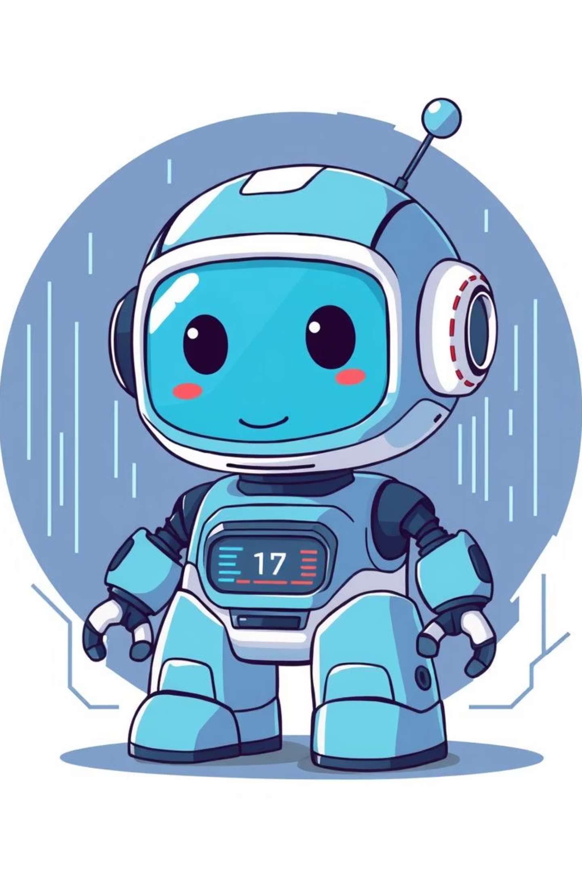
What I Learned from the Artificial Intelligence Course
From Theory to Practice: Search Algorithms, Games, and Intelligent Agents, CSPs
Presented by:
Mst. Tanzina Islam
ID: 0562320005101002
Course Code: CSE-06133115(Theory) & CSE-06133116(Lab)

Slide 2


What is Artificial Intelligence?
Definition & Scope
Core Goals
Artificial Intelligence refers to computer systems designed to perform tasks that typically require human intelligence. These include learning from experience, recognizing patterns, understanding language, and making decisions.
Create intelligent machines that solve complex problems
Enable systems to learn and improve from data
Develop reasoning and decision-making capabilities
Simulate human cognitive functions computationally

Slide 3

Intelligent Agents & Environments
Agent Types
Environment Properties
Simple reflex, model-based, goal-based, and utility-based, learning agents and act within their environments
Fully vs. partially observable, deterministic vs. stochastic, static vs. dynamic, discrete vs. continuous
Agent Design
Agents receive percepts through sensors and execute actions through actuators to achieve goals

Slide 4


Uninformed Search Algorithms
These algorithms explore the search space without using domain-specific knowledge, relying only on the problem definition.
1
Breadth-First Search (BFS)
Explores nodes level by level, guarantees shortest path in uniform-cost problems, but memory-intensive.
2
Depth-First Search (DFS)
Explores deeply along one branch before backtracking. Memory efficient but may find longer paths than optimal.
3
Iterative Deepening & Bidirectional Search
Iterative Deepening combines DFS benefits with BFS optimality. Bidirectional search searches from goal and start simultaneously.

Slide 5

Informed Search Algorithms
These algorithms leverage heuristic knowledge to guide the search efficiently toward the goal.
A* Search
Hill Climbing
Beam Search
Combines actual cost and heuristic estimate. Optimal and complete when using admissible heuristics. Widely considered the gold standard.
Greedy algorithm that moves toward the steepest improvement. Fast but can get stuck in local maxima without proper technique.
Memory-efficient variant that keeps only k best nodes at each level, balancing completeness and computational efficiency.

Slide 6

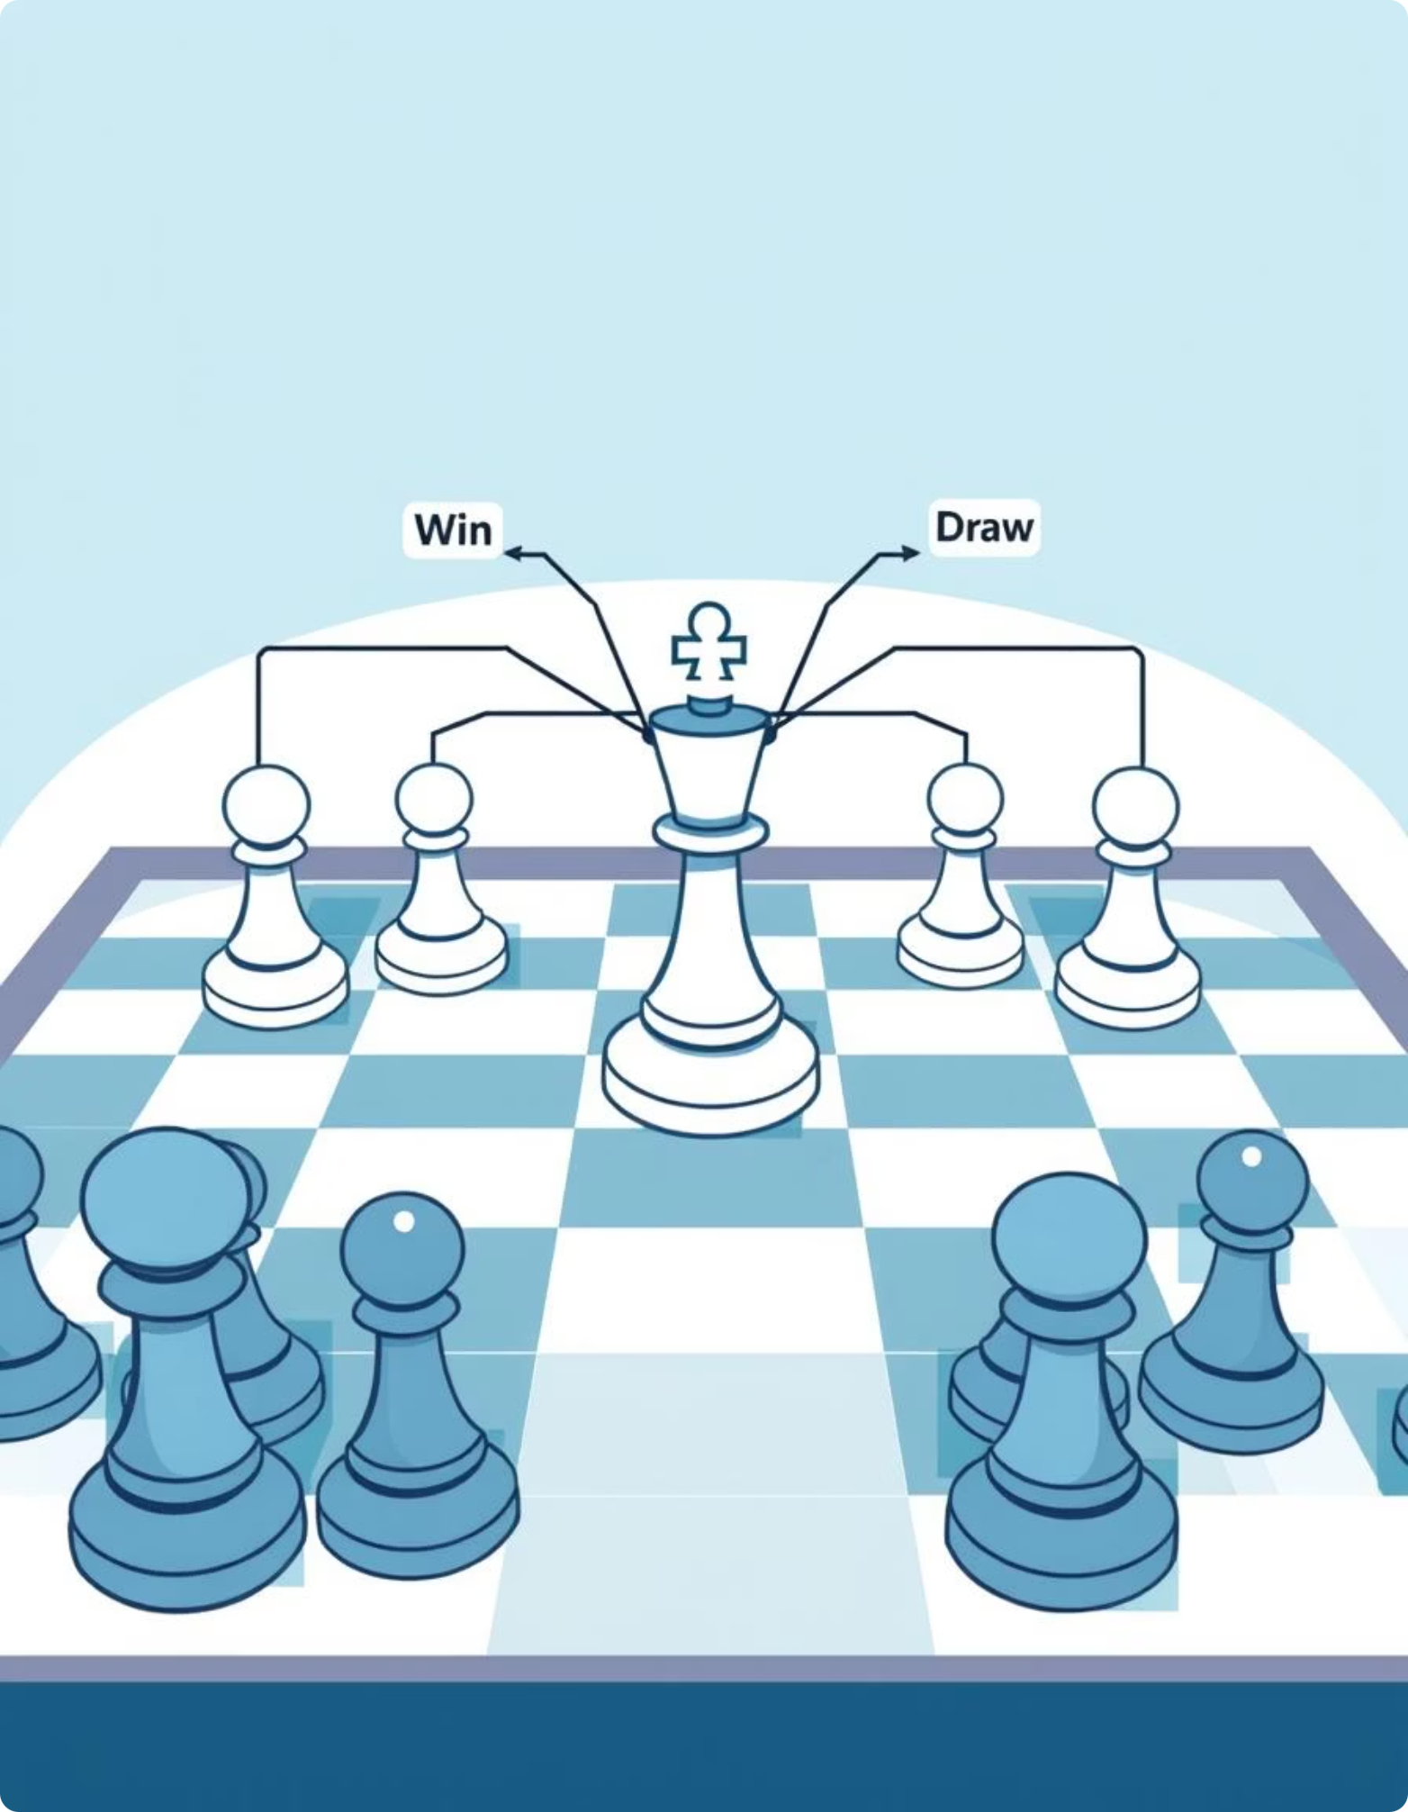
Game-Playing Algorithms
Adversarial search algorithms for two-player games where agents must consider opponent strategies and plan multiple moves ahead.
Minimax Algorithm
1
Explores game tree recursively, alternating between maximizing and minimizing players to find optimal strategy.
Alpha-Beta Pruning
2
Optimization of Minimax that eliminates branches guaranteed not to affect final decision, dramatically reducing computation.

Slide 7
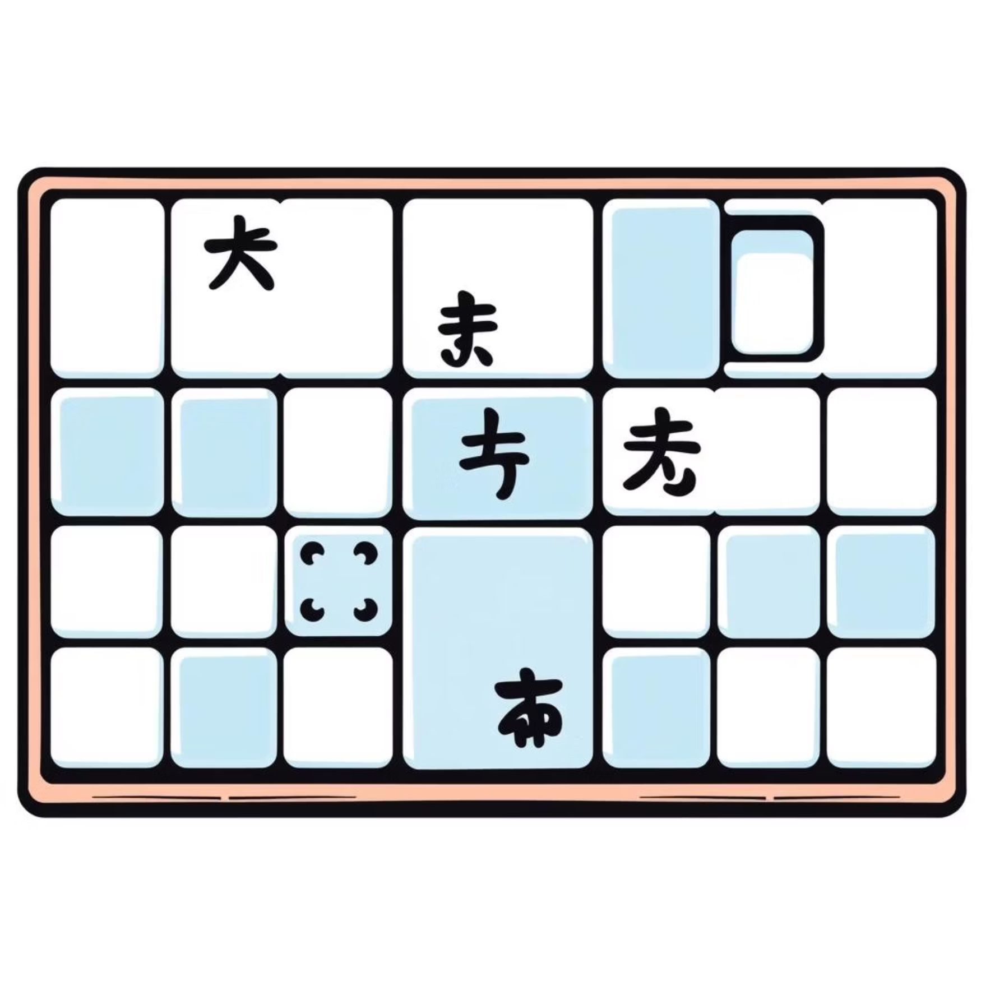
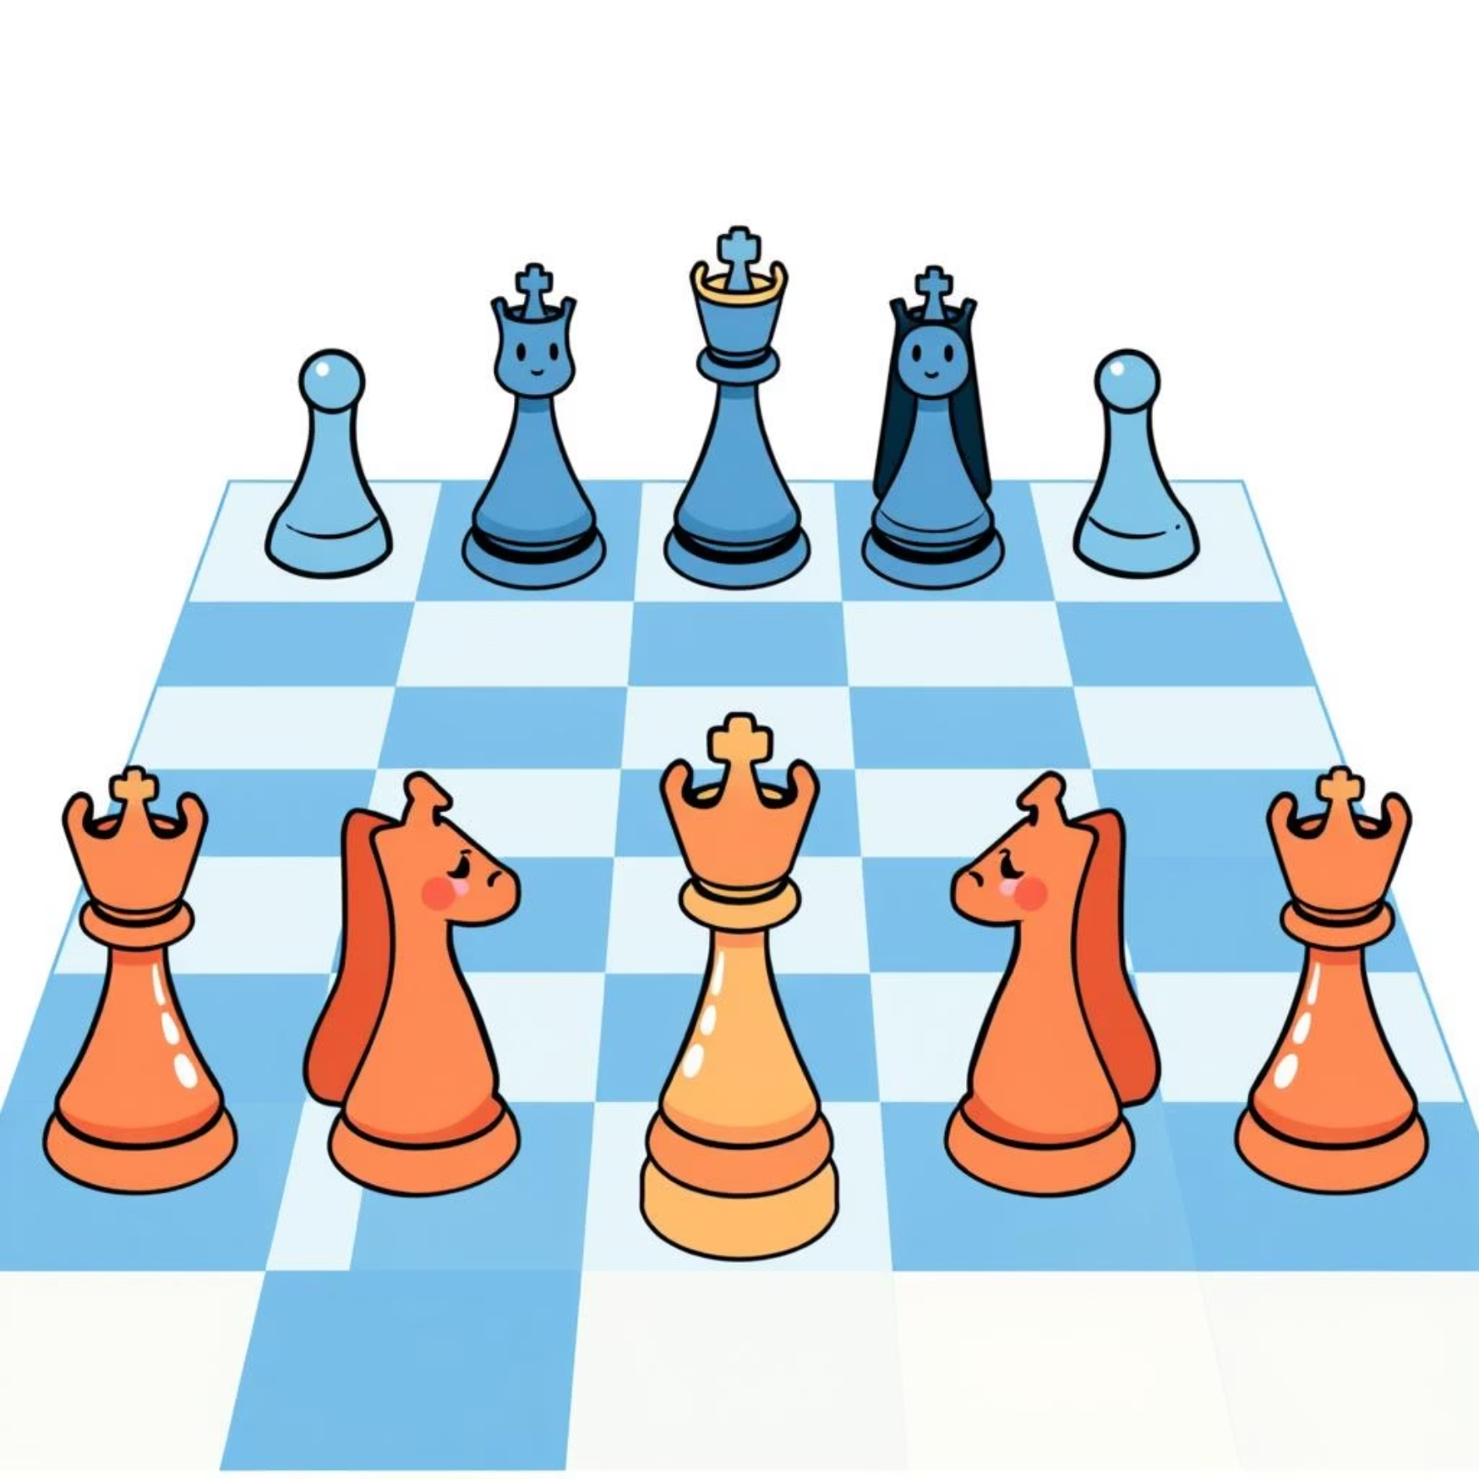
Classic Search Problems
Practical problem domains used to test and validate search algorithms, each with unique characteristics and constraints.
8-Puzzle Problem
N-Queens Problem
A 3×3 grid with 8 numbered tiles and one blank. Goal is to rearrange tiles to match target configuration. Demonstrates state-space search and heuristic design.
Place N queens on an N×N chessboard with no two queens attacking each other. Classic constraint satisfaction problem requiring backtracking and constraint propagation.

Slide 8

Constraint Satisfaction Problems
Systematic approaches to problems with variables, domains, and constraints, using techniques like node consistency, arc consistency, and path consistency.
01
Problem Representation
Define variables, their domains, and constraints governing valid value assignments.
02
Node Consistency
Remove domain values for individual variables that violate unary constraints.
03
Arc Consistency
Ensure that for every value in one variable's domain, there exists a compatible value in related variables' domains.
04
Path Consistency
Verify that value assignments to pairs of variables can be extended to consistent assignments with other variables.

Slide 9


Implementation & Practical Applications
Students implement all algorithms in their preferred programming languages, building real games and solving problems to deepen understanding.
Tic-Tac-Toe
Chess Engine
Implemented using Minimax algorithm to create an unbeatable player.
Leveraging Alpha-Beta pruning for efficient move evaluation in complex game trees.
Subtraction Game
Two-player game using Minimax to explore optimal strategies and game theory principles.

Slide 10

Learning Through Application
Implementation Benefits
Viva & Assessment
Direct discussion with instructors about design decisions, algorithm trade-offs, and problem-solving approaches deepens learning and prepares for professional AI development.
Coding algorithms reinforces conceptual understanding and reveals practical challenges like optimization, memory management, and edge cases in real systems.

Slide 11

Thank You!
We extend our sincere gratitude to our course instructor Mr. Razorshi Prozzwal Talukder sir for your exceptional guidance and dedication throughout this journey into Artificial Intelligence .
Thank you for a truly enriching experience!

